Slide 1
Kelompok Jarkom 5
Clara Edrea Evelyna Sony Putri (A11.2021.13374)
Faza Faresha Affandi (A11.2021.13917)
Muhammad Maulana Hikam (A11.2021.13550)
Yohanes Dimas Pratama (A11.2021.13254)

Slide 2
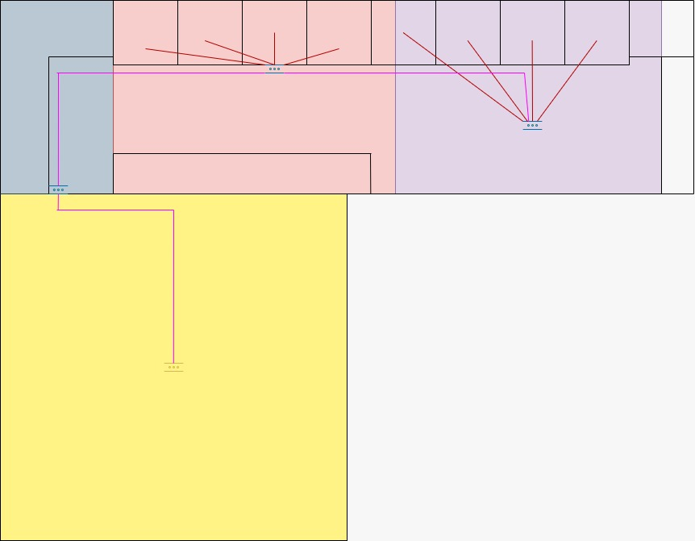
Desain Jaringan

Slide 3
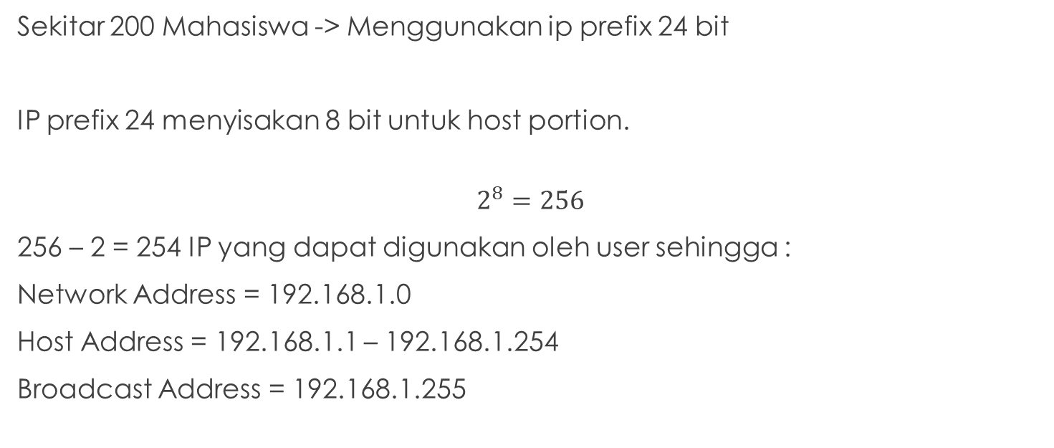
Pengalamatan IP
Sekitar 200 Mahasiswa -> Menggunakan ip prefix 24 bit
IP prefix 24 menyisakan 8 bit untuk host portion.
$$2^{8}=256$$
256 – 2 = 254 IP yang dapat digunakan oleh user sehingga :
Network Address = 192.168.1.0
Host Address = 192.168.1.1 – 192.168.1.254
Broadcast Address = 192.168.1.255

Slide 4
Spesifikasi Kebutuhan

Slide 5
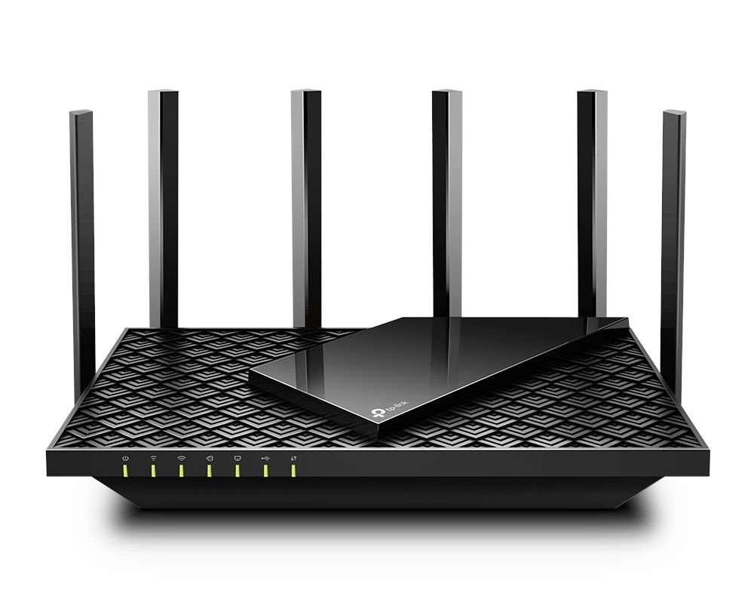
TP-Link Archer AX73 AX5400 Dual-Band Gigabit Wi-Fi 6 Router
Spesifikasi:
Gigabit WiFi for 8K Streaming
Fully Featured Wi-Fi 6
Connect 200+ Device
Extensive Coverage
HomeShield
More Vents, Less Heat
USB Sharing
Easy Setup
Harga: Rp1.700.000

Slide 6
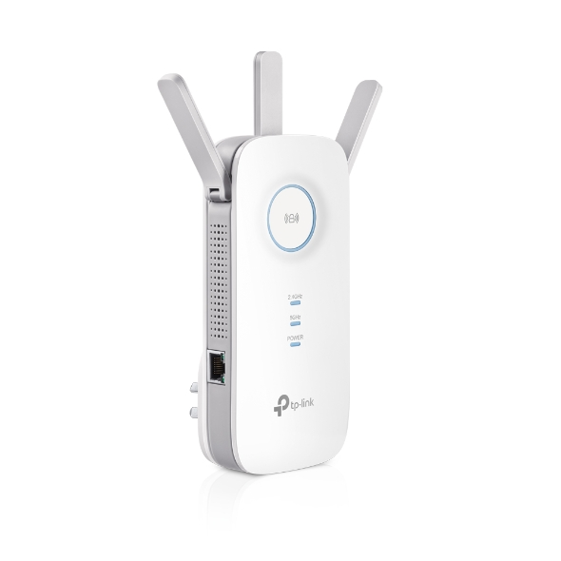
TP-Link AC1750 Wi-Fi Range Extender
Spesifikasi:
AC1750 Dual Band Wi-Fi
Three Antennas
Gigabit Ethernet port
Intelligent Signal Light
AP Mode
TP-Link Tether App
Ultimate Compatibility
Harga: Rp980.000

Slide 7

Kabel Lan Cat 6 / Cat6 Eyota / Kabel FTP Cat 6 Eyota (305M)
Spesifikasi:
Lan Cat6 Cabel
Professional networking Cabel FTP Cat6
Broadband Video 500Mhz
Gigatit Ethernet
155/622 Mbps ATM
10 Base T
100 Base T
TP, PMD
ISDN
Harga: Rp585.000

Slide 8
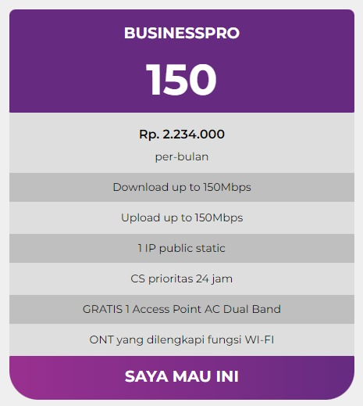
MyRepublic

Slide 9
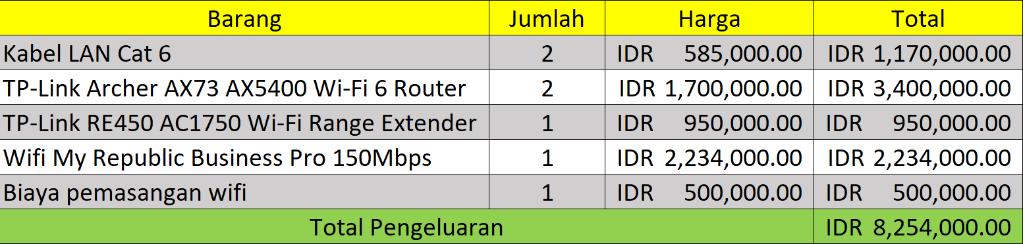
Biaya Pengeluaran

Slide 10
Sekian dan Terimakasih

